Slide 1
Data Collection and Transfer
Kevin Tran
Anand Varma

Slide 2
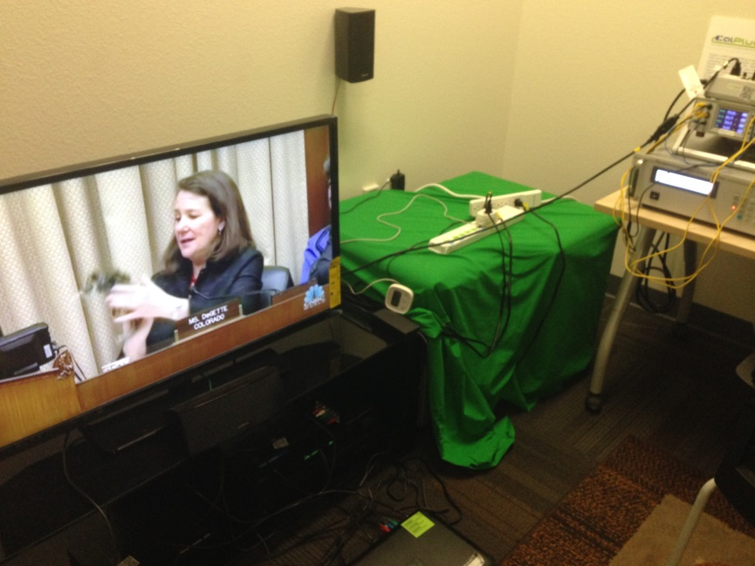
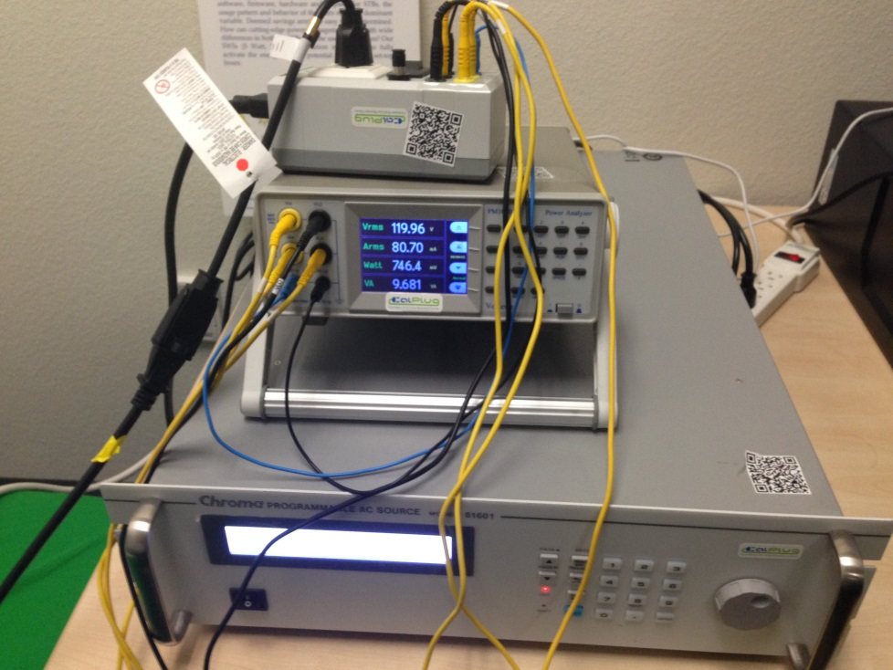
Data Collection
Power data is collected from electronics like a TV, audio, or set top box and is then sent through a power analyzer.

Slide 3
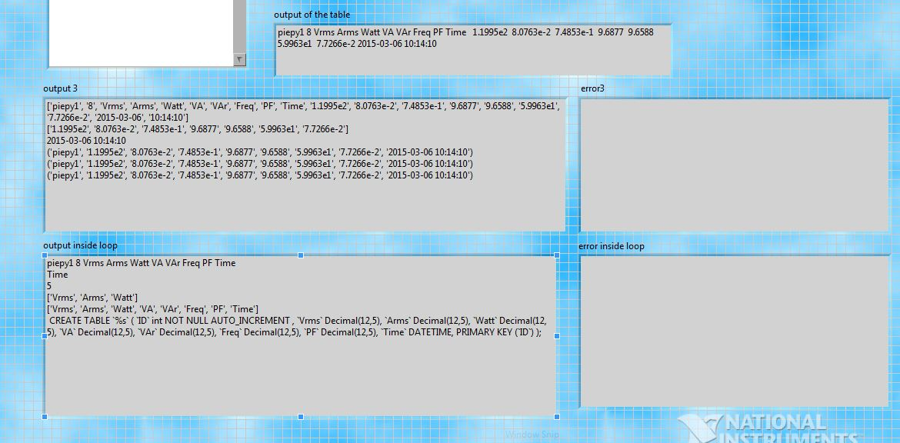
Front Panel
The power analyzer is connected to the computer. Then the computer uses a LabView program to collect and store data in an excel file for ready access. This is the front panel where users can select different options like number of tests, test length and variables to be tested.

Slide 4
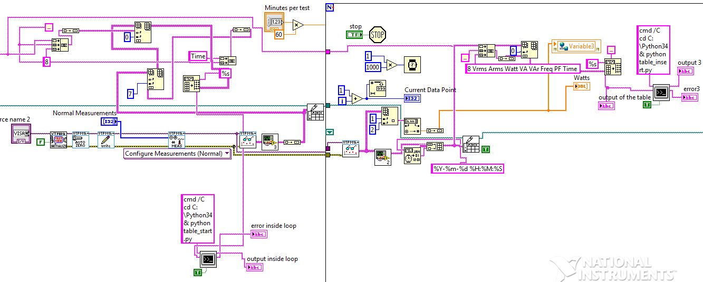
Block Diagram
The block diagram is essentially the backbone of the entire voltech program. Here we collect data, give it a timestamp, and transfer it to an excel file as well as to a MySQL database through the use of an integrated python program.

Slide 5
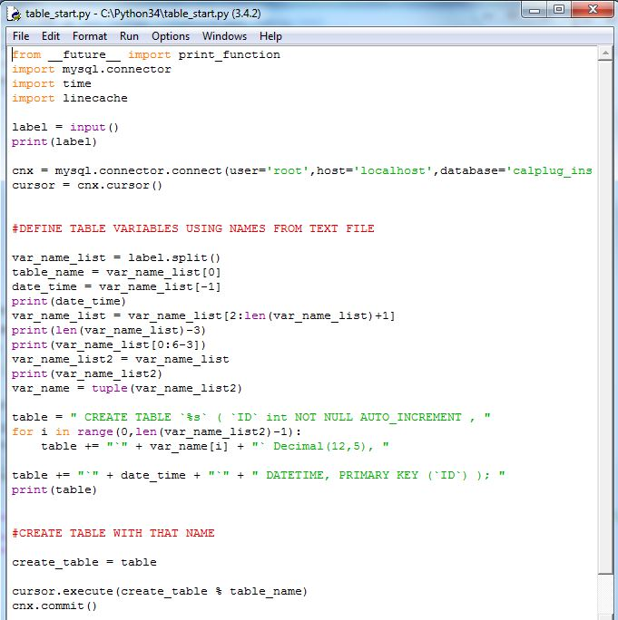
Database Initialization
One of two python programs are used in the Voltech program to create a SQL table. This program initializes a table for which the data is to be sent.

Slide 6
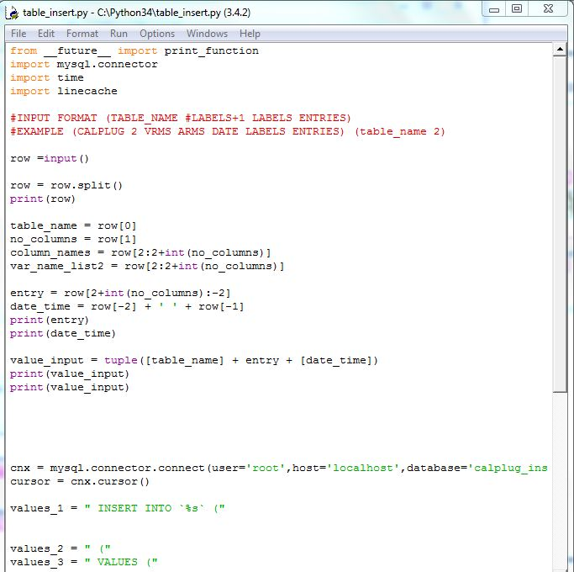
Database Transfer
This python program takes data and sends it to the newly created table.

Slide 7
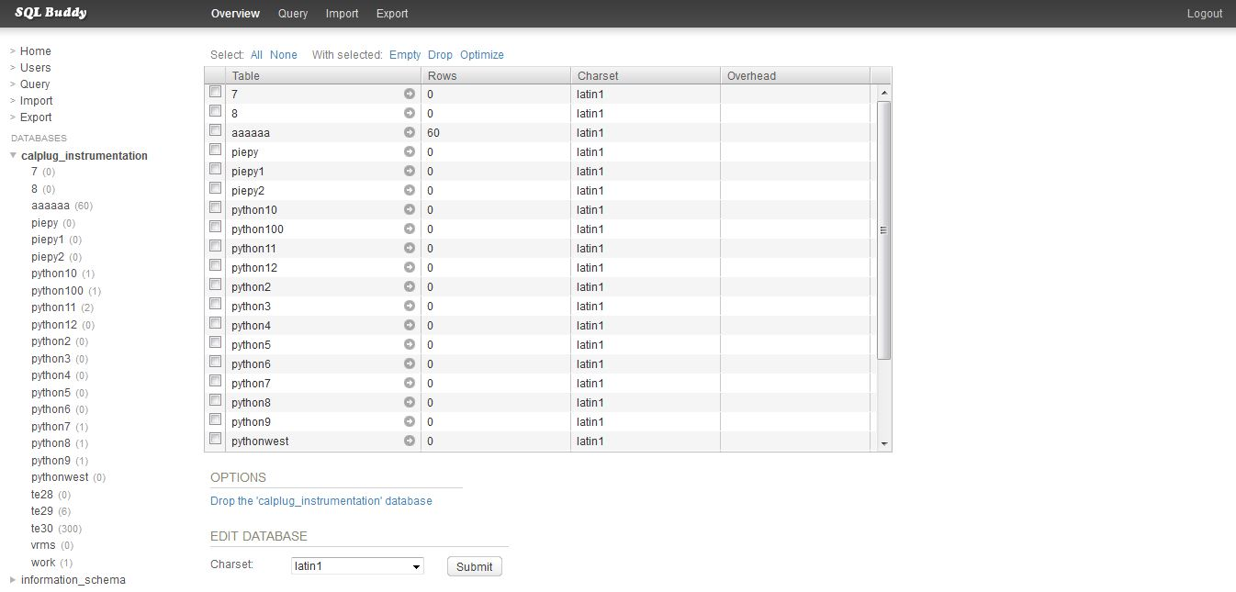
SQL Database
The data is sent to an online SQL database, where it can easily be accessed using PHP. Any team member can connect to the database and get the data they need.

